Slide 1
Perkins 3rd Quarter
Lorrie Toni, Perkins Director
Jan. 27, 2014

Slide 2
Initial Local Improvement Plan
One school/academic year’s data requires Local Improvement Plans two times:
Initial Local Improvement Plan and
Final Local Improvement Plan.
School Year or Academic Year of the Data | Fiscal Year of Perkins Local Plan in which INITIAL Local Improvement Plan for this data is completed (in January) | Fiscal Year of Perkins Local Plan in which Final Local Improvement Plan for this data is completed (first Local Plan submittal at beginning of fiscal year)
2010-2011 | FY2011-2012 Local Plan | FY2012-2013 Local Plan
2011-2012 | FY2012-2013 Local Plan | FY2013-2014 Local Plan
2012-2013 | FY2013-2014 Local Plan | FY2014-2015 Local Plan
2013-2014 | FY2014-2015 Local Plan | FY2015-2016 Local Plan

Slide 4
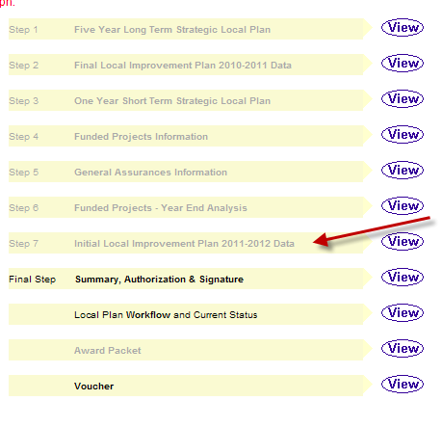

Slide 6
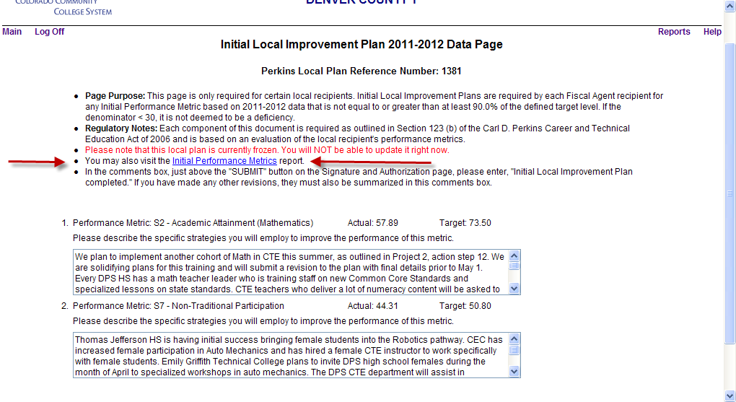

Slide 7
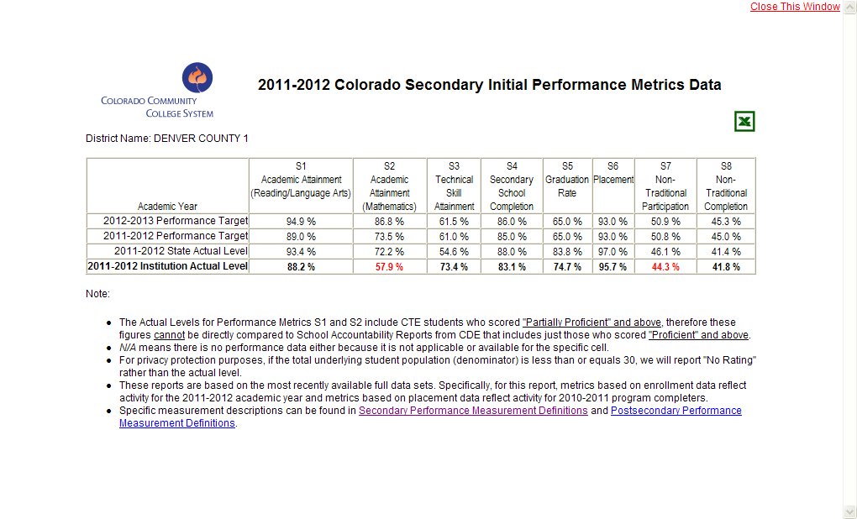

Slide 8
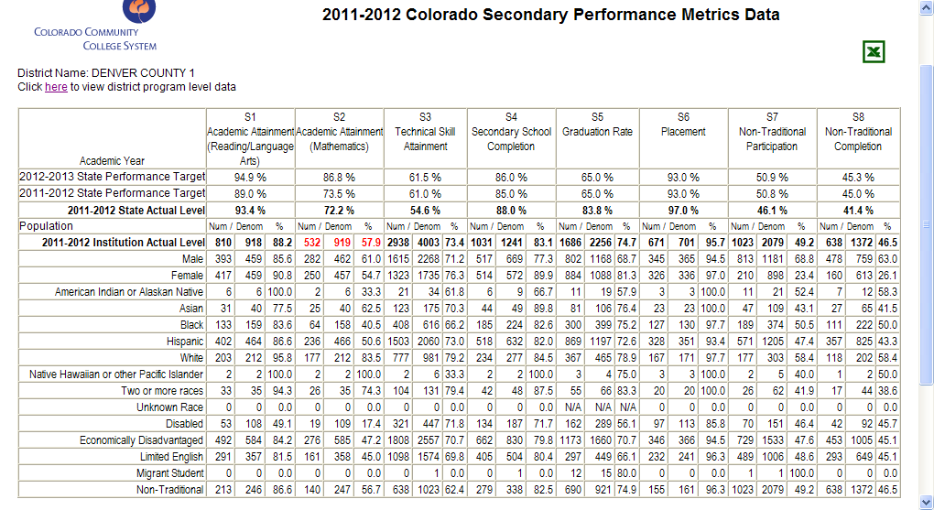

Slide 9
Intent-To-Participate
Notification
Can change contact information – will start immediately if different
Plan of Study Question
Consortia Directors need to wait until all member districts complete theirs
Takes only a few seconds

Slide 10
Local Plan Revisions
Use the guide – click to open the Local Plan
New action steps have to meet same requirements as old action steps:
Do X
To accomplish Y
How it supports the first project objective
Careful regarding equipment action steps – see guide

Slide 11
Some – Need a 2nd Voucher
See Administrators’ Handbook – If allocation total is greater than $100,000.
Quarterly vouchers – good idea for all

