Slide 1
Relational Leadership
Transforming leadership For the times we are living
Building a “vulnerability based trust” organizational culture
Notes:
Talk about the differences between predictive trust and vulnerability based trust – Lencioni - 5 dysfunctions of team, lack of trust, leads to fear of conflict, leads to lack of commitment, leads to avoidance of accountability, leads to inattention to results

Slide 2
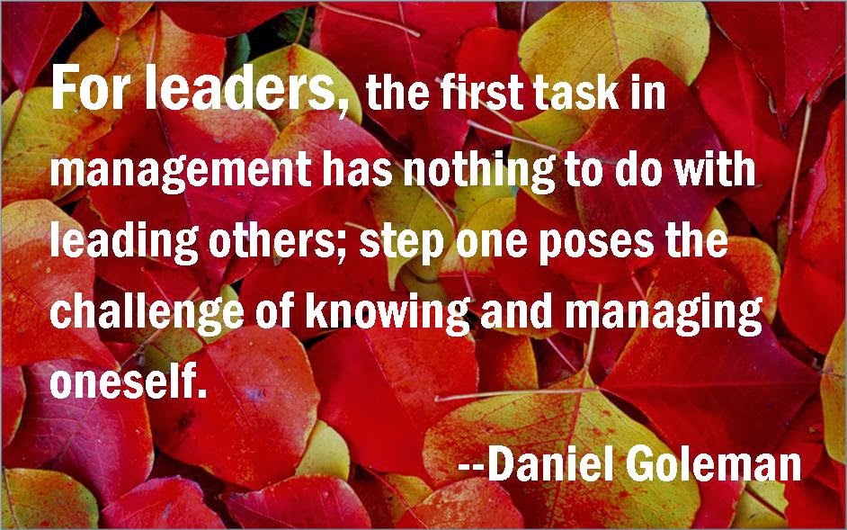
Leadership
Notes:
Relational leadership is about self-examining the way that leaders build relationships with those they lead. The self—exploration is also about how leaders message the importance of building relationship between adult staff in their buildings.

Slide 3
outcomes
Disrupt hierarchical leadership behaviors that no longer serve us
Understand the importance of relationship building in organizational culture
Know how to use vulnerability based trust in building strong impactful cultures
How to use a growth mindset in building relational leadership
Notes:
Characteristics of vulnerability based leadership are rooted in self-awareness and building skill bases. These outcomes are designed to disrupt the current system of hierarchal leadership. Patrick Lencioni talks about the differences of predictive trust and vulnerability based trust. Equity and inclusion are rooted in relationship and leaders have to get comfortable being vulnearble

Slide 4
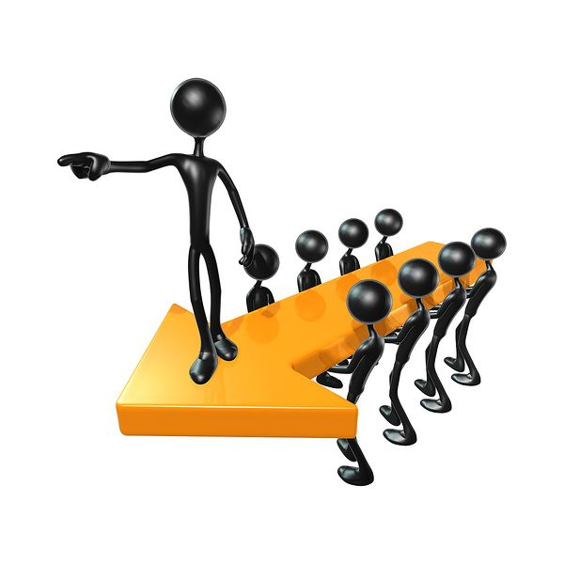
Positional vs. Relational
What is the difference in leadership?

Slide 5
Relational Leadership
Leaders must create positive relationships at all levels of the team
Attributes:
Systems Builder
Inclusive
Empowering

Slide 6
Relational Shift
Move out of silos Move from Programmatic technical fix To People, systems and adaptive transformation

Slide 7
Talk to a partner
What are your thoughts about relational Leadership
What are the biases you have about leadership?

Slide 8
Questions to think about
How do you operationalize relationships with colleagues and students using culturally responsive pedagogy and practices?
What implications does equity have on coaching teachers?
What is the role of equity in creating differentiated learning for students?
Notes:
These are curriculum, professional development, and content specialists that are there to help teachers with student learning. One of the first steps of your coaching conversation should be to build a relationship with the teacher. This is especially important if you are in a building where you were a colleague and now you are in the role of your colleagues observer.
--student engagement and its importance
--personalized learning experiences
--Equity: What implications does that concept have on learning?
--Relationships being the umbrella:

Slide 9
Agenda
Introductions – Opening Remarks
Personal Agreements
Listening activity
Bias awareness – deep listening – purposeful conversations

Slide 10
Personal agreements
Awareness of judgment that leads to blame or shame
Limit side conversations
Respectful use of electronics
Accept and expect non-closure
What’s said here stays here- What’s learned here leaves here
Experience discomfort
Stay engaged
Speak your truth

Slide 11
“Finding your “why”
“People do not follow how or what, they follow why” Simon Sinek
Notes:
Why are you in educational leadership? What do you want to disrupt, impact or change? Your why should be bigger them yourself and anything else?

Slide 13
My Why “make the world a more humane place”
Talk with a colleague and share your “why”
“When you know your why, your what has more impact because you’re walking in or towards your purpose” ~ Michael Jr.

Slide 14
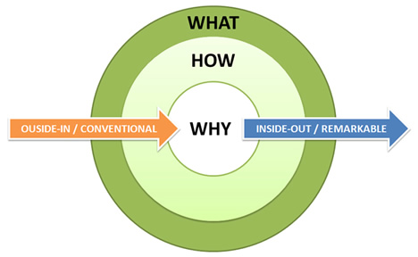
“How Great Leaders Inspire Action”
Simon Sinek: Golden Circle
Notes:
So what are we up to today?

Slide 15
Relational Leadership
Communication of the vision – “Why”
Involved in change efforts
Act as Role Models
Develop Systems and Processes
Transformational

Slide 16
The unconscious mind…
11 million pieces of information a second
Only 40 are conscious

Slide 17
Enhanced self-awareness is the key to relational leadership
Notes:
Dr. Daniel Goleman has been researching social emotional intelligence and from my perspective the most important element to increase social emotional intelligence is self-awareness. Increasing self-awareness is a skill that has to be intentionally worked on each day.

Slide 19
Patriarchal Leadership
Notes:
Let’s look at leadership structures. Education is dominated by women and yet at higher levels of leadership many leaders are men. How does a women succeed in a patriarchal governance structure? What are the leadership attributes that will disrupt a style of leadership that has been in place since the start of education.
Talk about the politicization of education and how you have seen bills that were in the best interest of children, die in split votes from partisan politics. With no real conversation or debate about the merits of the outcomes on children. Positional politics is killing our kids.
Culturally we operate in a male oriented euro-centric culture and we live in a multi-cultural world where leaders are not defined by a gender.

Slide 20
Women in higher positions of leadership
Socialization as children such as culture, family and social stereotypes and narratives affect the development of leadership skills and capacity
What are the differences in leadership models between men and women?
How would others rate your leadership skills?

Slide 21
Adaptive Leadership
Ron Heifetz – Research on Adaptive Leadership Harvard Kennedy School
Technical problems vs. adaptive problems
Curiosity was more valued than obedience to rules
General dialogue neutralized hierarchal power
Ideas were encouraged as a way of appreciating a variety of perspectives, (diversity).
Notes:
Much of our work in educational transformation is rooted in finding the right program to fix the system. For the past 100 years we in education have used programs to push education change, higher academic performance and lower discipline referrals. There has not been a program that has achieved these outcomes and if there were we would all be using them and there would be no need for these types of gatherings. How many programs are you using in your schools and how do you know which one is making a difference is your measured outcomes?

Slide 22
Adaptive leadership
Confidence in people to work together across organizational boundaries
Respect for curious minds and interesting questions
Encouraging strategic alliance
Developing organizational abilities through encouraging and supporting people to lead at any level of the organization
Ron Heifetz, (1997)

Slide 23
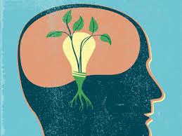
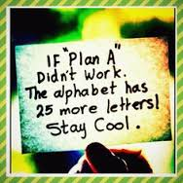
Growth or fixed mindset
Carol Dweck – Mindset
research on the Impacts of
Fixed and Growth Mind sets – Stanford

Slide 24
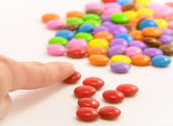
Cognitive bias
Cognitive Bias
Unconscious evaluations /evidence that people use as the basis of decision making rather than engage in a more detailed analysis and reasoning process, (MacGregor, 2002).

Slide 25
Equity: We Celebrate our Diversity and Will Provide Necessary Resources and Supports to Eliminate Barriers to Success and Foster a More Equitable Future For All Our Kids.
Notes:
This is our DPS definition of Equity based on shared core values

Slide 26
Implementation of Equity within curriculum, PD and coaching teachers
In decisions regarding educational equity, the following must be considered:
Opportunity: An equal opportunity to gain entry.
Access: All students are provided educational experiences that ensure the achievement of certain uniform goals and objectives.
Inclusive Process: A state beyond nondiscrimination that is characterized by fair and just, but not identical treatment.
Implementation: Differentiation Based on Need
Adapted from The College Board. (2000). Educational equity school level services PACESETTER July, 19, 2001.
Notes:
curriculum, professional development, and content specialists that are there to help teachers

Slide 27
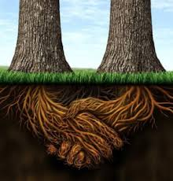
Equity/Inclsion is rooted in relationships

Slide 28
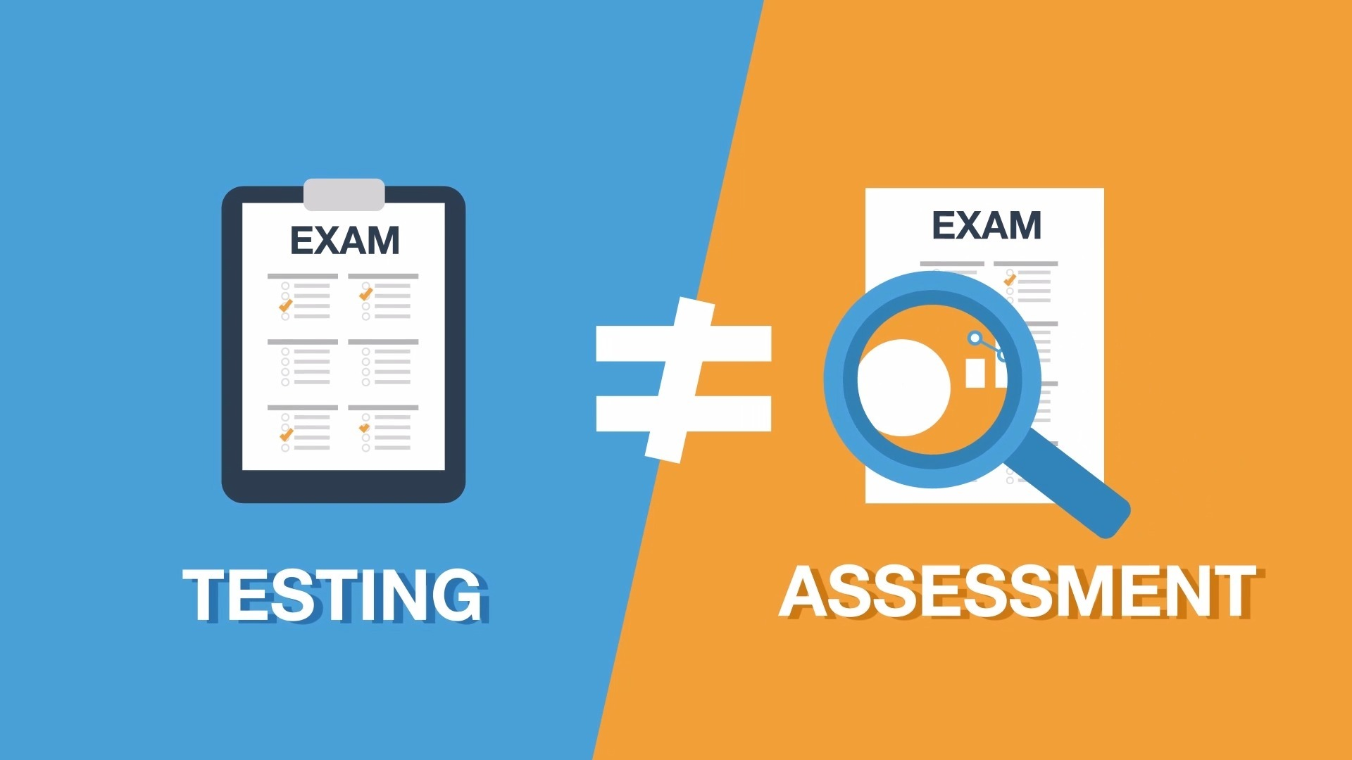
Equity is Rooted in Relationships - What is the Balance of Assessment and Relationships?

Slide 29
WHAT IS A SYSTEM? Events Effects Patterns
Patterns Underlying Structures Mental Models Cultural & Institutional Values
Notes:
Connect events to “What is the dominant narrative”

Slide 30
WHAT IS A SYSTEM?
Events
Effects
Patterns
Conscious
Individual
Lens
Interpersonal and Internalized Racism
Achievement
Gap
Patterns
Underlying Structures
Mental Models
Cultural & Institutional Values
Subconscious /
Unconscious
Systems
Lens
Institutional and
Structural Racialization
Opportunity
Gap

Slide 31
UNCONSCIOUS (IMPLICIT) BIAS
When an individual’s actions or decisions towards a group of people are driven by the internalized stereotype messages about that group, often at odds with conscious values and beliefs. Cognitive Dissonance
RACISM
A prejudice that maintains that members of one racial group are superior to another group. This prejudice may lead to dominance, animosity and/or discriminatory behavior against members of the perceived unequal or “inferior” group.
It is important to think about racism as manifesting in FOUR ways:
Internalized
Interpersonal
Institutional
Structural
BIAS ≠ RACISM

Slide 32
All levels of a system must be addressed.
Notes:
What? implementable solution/approach to an equity problem
A recognition and belief that to transform and sustain change we have to work at the individual, institutional level and understand and influence the structural arrangements that are at play
In service of interrupting and providing catalytic innovation for systems change.

Slide 33
PURPOSEFUL CONVERSATION
Establish the purpose. Why are we here and what is the purpose of this conversation?
What do you hope to accomplish through the conversation?
What evidence during the conversation will lead you to know you have been successful?
What do you want to be sure you do well during the conversation?

Slide 34
Clear Deep Listening
Awareness of- Judgment that leads to Blame - Shame
Accept what others have to say
Breathe and pause before responding
Reflection
Redirect yourself to be a positive contributor when needed
Respond, don’t react
Notes:
Skill based training and focus - Listening exercise helps you to be more aware of whether you are more responsive or reactive – for a more productive coaching session it is importatn to bemore responsive – maintain the relationship is critical to the observation feedback conversation

Slide 35
Deep Listening with Thich Nhat Hanh
Notes:
https://www.youtube.com/watch?v=lyUxYflkhzo

Slide 36
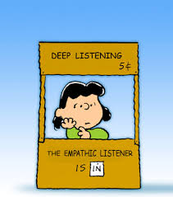
Deep Listening Reflective Questions
How can purposeful conversations and deep listening impact a relationship?
How can purposeful conversations and deep listening help the speaker in the conversation?

Slide 37
RACE is still one of the most
powerful predictors of how a person will fare in society
Notes:
WHY Focus on RACE How do you have coaching conversations when you believe that race, ethnicity or ELL issues are at play? Are you comfortable having these conversations? This work is about practice and not perfection – The ability to sit in race, class, bias, ethnicity and ELL conversations is to practice having them
– we
Over the last decade we have developed a methodology that increases people’s capacity to identify, interrupt, address and mitigate the harmful effects of this particular form of oppression.
In schools…
In organizations and agencies…
In community…
RE Leadership & Team DEV & Healing
Strategy DEV & Implementation Support
Design – New processes, structures, experiences
Community Engagement

Slide 38
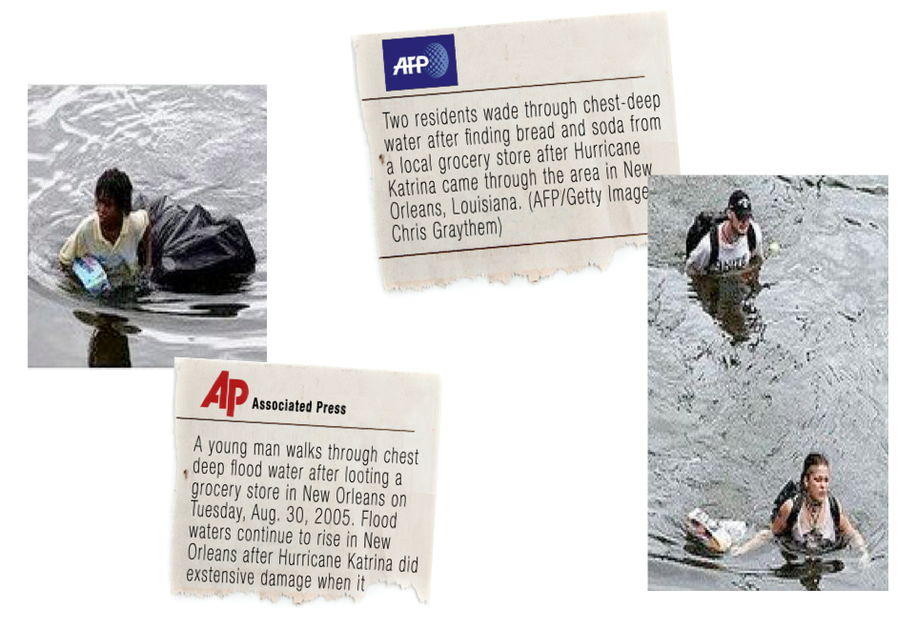

Slide 39
Bias is simply each person’s unique predisposition of how to see the world. It’s our own thinking when we are confronted with new events.
A pre-formed negative opinion or attitude toward a group of persons based on their race, religion, disability, sexual orientation, age, ethnicity...
Bias is used to describe a tendency or preference towards a particular perspective, ideology or result.

Slide 40
Manifestation of Bias
All information and points of view can generate some form of bias.
All biases come with a common set of thoughts, expectations, language and behaviors.

Slide 41
Bias, Influence and Building Relationships
How do your biases show up? Name a bias you are willing to share.
Do your biases inhibit or enhance your ability to be in authentic relationship?
How do individual and systemic biases impact and influence your school culture ?

Slide 42
Conflict HAPPENS
Conflict is…
a normal, inescapable part of life
a periodic occurrence in any relationship
an opportunity to understand opposing preferences and values
ENERGY

Slide 43
Building systems that support inclusion conversations
Create a strategic plan
Processes, protocols and practices that are consistent
Build Cross functional capacity
Replicable
Build capacity
Move away from a programmatic approach
Facilitative systems that replicable and simple
Build into UIP goals

Slide 44
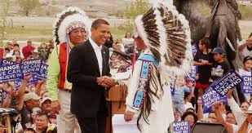
Culturally Responsive Teaching is NOT…
Making vests out of brown paper bags and headbands adorned with feathers to learn about Native Americans….
Notes:
1 minute

Slide 45
“When we create
effective communities
of learners in which the
needs of all learners
are specifically and
systematically
addressed, we will go a
long way toward
addressing both equity
and excellence in
schools.”
(Thomlinson, 1999)
Notes:
1 minute
A strong community of learners honors each student individually and expects excellence from all.

Slide 46
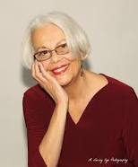
Culturally Responsive Teaching Is…
“Culturally responsive education recognizes, respects, and uses students’ identities and backgrounds as meaningful sources for creating optimal learning environments,” (Nieto, 2001)
Notes:
2 minutes
Think about your cultural suitcases that you packed earlier, think about how you can use the knowledge gained from creating those suitcases with your students, to build on their strengths and interests, and inherently their cultures

Slide 47
Conflict HAPPENS
Conflict is…
a normal, inescapable part of life
a periodic occurrence in any relationship
an opportunity to understand opposing preferences and values
ENERGY

Slide 48
I’ve come to the frightening conclusion that I am the
decisive element in the classroom.
It’s my daily mood that makes the weather.
As a teacher, I possess a tremendous power to make a
child’s life miserable or joyous.
I can be a tool of torture or an instrument of inspiration.
I can humiliate or humor, hurt or heal. In all situations,
it is my response that decides whether a crisis will be
escalated or de-escalated and a child humanized
or de-humanized.
–Haim Ginott
.
Notes:
4 minutes
Read the slide and make notes in your journal about what you have learned, whether you believe that you have hit the learning targets for this session, or any other ideas you’d like to remember, record, or discuss later. Be able to know and embrace your role and power in the classroom. Let this quote remind you of your role as a teacher

Slide 50
Questions Comments, thoughts
Bill de la Cruz
b.delacruz@comcast.net
303-875-0070

